Slide 1







The Scientific Pursuit of Happiness
Cornell University
November 10, 2004

Slide 2
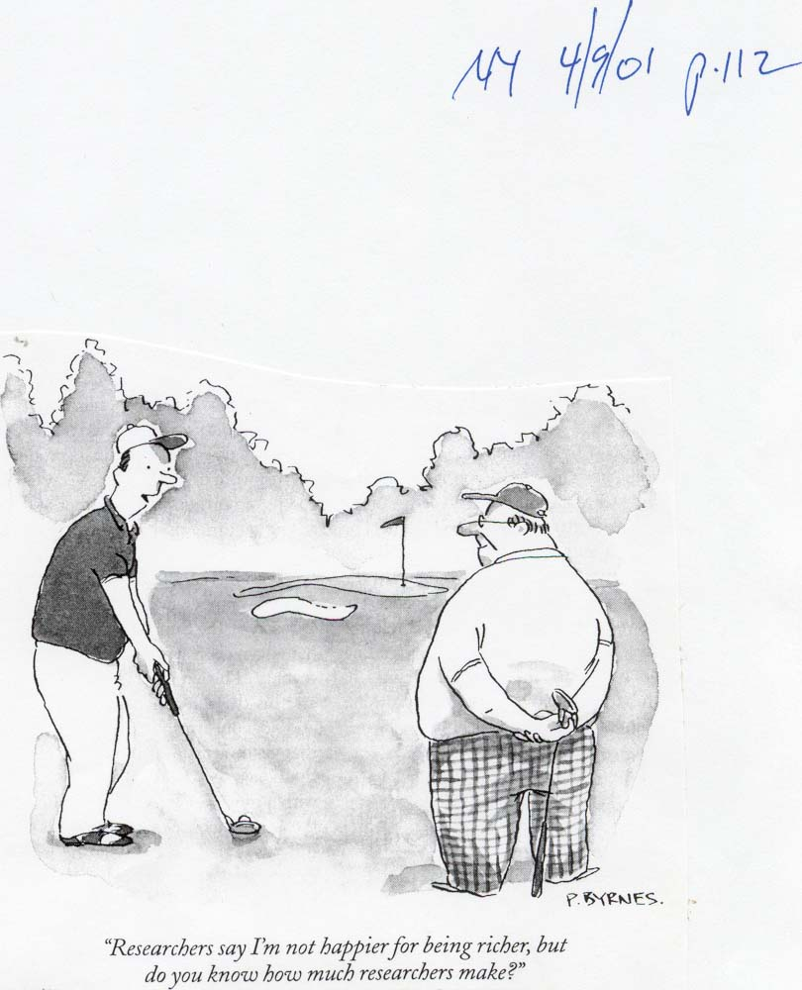

Slide 3
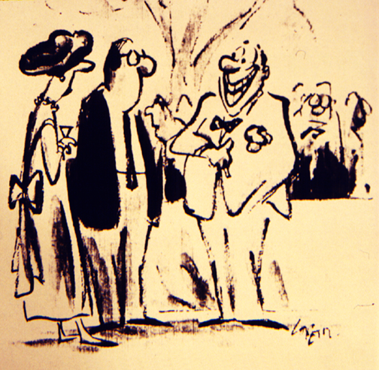
“I’ve always been happy, but lately
I’ve turned it up a notch or two.”

Slide 4
Percent “Satisfied” or “Very Satisfied” with Life as a Whole
Percent
100
80
60
40
20
0
15- 24
25- 34
35- 44
45- 54
55- 64
65+
Age group

Slide 5
Percent “Very Happy” among Married and Never Married Americans
Married
Never married

Slide 6
Marital Satisfaction and the Family Life Cycle
56
Rollins-
Feldman
55
54
Locke-Wallace
53
52
Satisfaction
51
50
Blood-Wolfe
49
British study
48
47
46
Married
without
children
Child-
bearing
Pre-school children, oldest 5
School
children
oldest
5-12
Teenagers oldest
12-16
First child gone to last leaving
home
Empty
nest to retirement
Empty
nest to
death of
first spouse

Slide 7
B. Does Money Buy Happiness?
1. Are people happier if
they live in rich countries?

Slide 8
Personal income
(in 1995 $)

Slide 9
Personal income
(in 1995 $)
Very happy (%)

Slide 10
% “Very important or essential”
Be very well off financially
Develop a meaningful philosophy of life

Slide 11
Who Is Happy?
2. Women or men?

Slide 12
Gender and Well-Being in Sixteen Nations
Percent
100
Males
80
Females
60
40
20
0
Satisfied
Very happy
Pooled data from 169,776 interviews.

Slide 13
Redefining Progress
(1) Progress = standard of living
= material well-being
= unsustainable development
(2) Progress = quality of life
= total well-being (physical, mental, social and spiritual)
= sustainable development

Slide 14

Well-Being and
Being Well-Off
A. The presumption that
money buys happiness

Slide 15
Negative versus positive topics in psychology journal articles 1887 to 2003
93,381 on “depression”
23,790 on “fear”
242,134 on “treatment”
4,247 on “happiness”
933 on “courage
38,349 on “prevention”

Slide 16
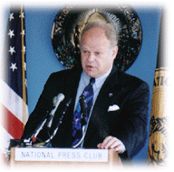
A more positive psychology for the twenty-first century?
Seligman’s “three pillars”
of positive psychology:
Positive subjective well-being
  life satisfaction/happiness/optimism
Positive strengths and virtues
  creativity/courage/compassion/integrity/wisdom/self-control/spirituality
Positive institutions
  healthy families/neighborhoods/schools/media

Slide 17
What Is “Subjective Well-Being”?
1. Feeling happy: “Taking all things together, how would you say things are these days — would you say you are very happy, pretty happy, or not too happy?”

Slide 18
What Is “Subjective Well-Being”?
2. Thinking life is satisfying: “How satisfied are you with your life as a whole these days?”

Slide 19
How Happy Are People?
1. Self-reports are mostly positive

Slide 20
Subjective Well-Being
916 Surveys in 45 Nations
160
Average = 6.75
on 0 to 10 scale
140
120
100
80
60
40
20
0
1.50
2.50
3.50
4.50
5.50
6.50
7.50
8.50
2.00
3.00
4.00
5.00
6.00
7.00
8.00

Slide 21
10,126 momentary moods reported by 226 SMU students (Watson, 2000)

Slide 22
Students’ language use in natural conversation (>10,000 slices)
Matthias Mehl and James Pennebaker at University of Texas

Slide 23
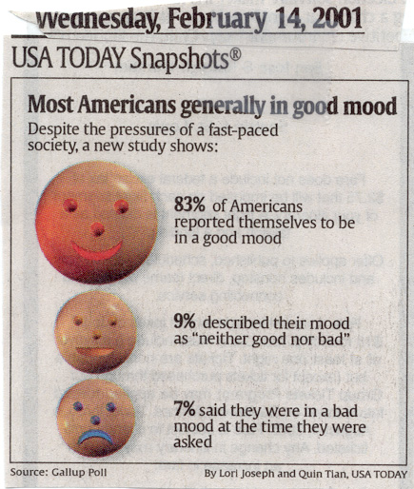

Slide 24
20%
46%
27%
4%
2%
1%
0%

Slide 25
Can we trust these self-reports?
Are happy people “in denial”?
The happiness thermometers may read a little high, yet . . .
Self-report measures are:
  reliable
  correlated with experience samplings
  correlated with positive indicators
  correlated with others’ reports
  the only measures of subjective well-being

Slide 26
Who Is Happy?
1. Young, middle-aged, or old?

Slide 27
1. Young, Middle-Aged, or Old?
A. Changing emotions
B. Threats to well-being?
Mid-life crises and empty nests

Slide 28
Selected Disorders, by Sex
Males
Percent
Females
100
90
80
70
60
50
40
30
20
10
0
Depression
Schizophrenia
Alcoholism
Psychological disorders
Data from M. Argyle, 1987.

Slide 31
Married
Never married
Separated
Divorced

Slide 32
Subjective Well-Being of 82 Countries
(Combined happiness and life satisfaction, from
1999-2001 World Values Surveys reported by R. Inglehart, 2004)
Puerto Rico
Mexico
Denmark
Ireland
Iceland
Switzerland
Northern Ireland
Columbia
Netherlands . . .
. . . USA (#15)
. . . Bulgaria
Belarus
Georgia
Romania
Moldova
Russia
Armenia
Ukraine
Zimbabwe
Indonesia

Slide 33
B. Does Money Buy Happiness?
2. Within a country, are
the richest the happiest?

Slide 34
Australian Living Standards Survey, 1991-1992
(percent reporting high life satisfaction)

Slide 35
Americans “very happy” (Gallup, 2003)

Slide 36
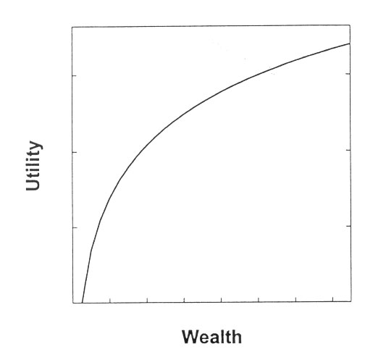

Slide 37
B. Does Money Buy Happiness?
3. Does the happiness of a people
rise with their affluence?

Slide 38
% Homes with
Air Conditioning
Percent
100
80
73
60
40
20
15
0
1960
1997

Slide 41
Suicide Rate, Ages 15 to 19
(per 100,000)

Slide 42
Teens from affluent families suffer elevated rates of
Anxiety
Depression
Substance use
Eating disorders
(related to achievement pressures and isolation from adults, suggests one analysis)

Slide 43
The Traits of
Happy People

Slide 44
The Traits of Happy People
A. Self-esteem: Happy people
like themselves
  Self-serving bias
  Self-esteem and happiness in stigmatized groups

Slide 45
The Traits of Happy People
B. Personal control: Happy people
believe they choose their destinies
C. Optimism: Happy people
are hope-filled
D. Extraversion: Happy people
are outgoing

Slide 47
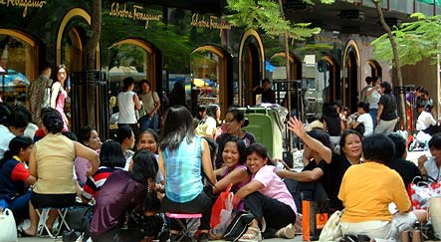
Social Support
A. Close relationships and health
B. Close relationships and happiness

Slide 48
Love and Marriage
A. Marriage and well-being

Slide 49
% Very Happy
(NORC: N = 41,974, 1972-2002)

Slide 50


Slide 51
Spirituality and Happiness
Percent “very happy”
100
80
60
40
20
0
Low
High
Spiritual commitment
From Gallup survey of adult Americans.

Slide 52
% Very Happy and Felt Closeness to God
(n = 9896, NORC, 1983-1991)

Slide 53
% Very Happy and Belief in God
(1998 USA data reported by Tom Smith for International Social Survey Program)

Slide 54
% Very Happy and Religious Attendance (n=41,527, NORC, 1972-2002)

Slide 55
What Faith Offers
1. Social support (religio = to bind together)
2. Meaning and purpose
3. Ultimate acceptance
4. Focus beyond self
5. Eternal perspective

Slide 56
How to Feel Better
1. Realize: enduring happiness doesn’t come from making it
2. Savor the moment
3. Take control of your time
4. Act happy
5. Seek work and leisure that engage your skills
6. Join the movement movement
7. Get REST
8. Give priority to close relationships
9. Count your blessings—keep a gratitude journal
10. Take care of the soul

Slide 57
For further information . . .
davidmyers.org

